Slide 1



ENTREPRENEUR CURRICULUM
Session 1
Based on the book, Find A Need. Fill A Need. Get Paid. by Will Holmes
Copyright 2026. All Rights Reserved.

Slide 2

This Week
Session 1
Introductions, Program Orientation & Business Challenges
During this 3-hour session, we will discuss the goals of the program, expectations and the final presentation. Participants will introduce themselves and share their greatest business challenges. We will discuss cash flow projections, common business challenges, the resource page and the final presentation. We will take a short break at 7pm and 8pm and end at 9pm.
Homework will be assigned to be submitted by the next class.
Copyright 2026 www.whcusa.com
www.whcusa.com
2

Slide 3

WELCOME
Anne Arundel County Economic Development: Barbara Quaye
Mentors:
LAW: Yoscaisa Jorge & Francisco Mundaca
ACCOUNTING: Catherine Wright & Zokpia Olumese
MARKETING: Tyrus Shivers
HR: Hennither Grant
OPS: Dr. Rhonda Farrell
Facilitators:
Will Holmes & Dr. Imani Coles
Contact info, homework and resources:
https://www.skool.com/whc
1
Welcome and Remarks from Anne Arundel County
2 Attendance Link & SKOOL
3
Facilitator and Business Owner Introductions
4
Discussion
5
Q&A

Slide 4

Attendance
https://whcusa.com/ivp-attendance/
Copyright 2026 www.whcusa.com
4

Slide 5
Homework and Resources Page
https://skool.com/whc
Copyright 2026 www.whcusa.com
5

Slide 6
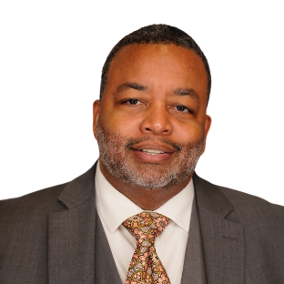




Will Holmes
Founder of WHC
Established in 2006 | Serving Government Agencies, Banks, Universities and Entrepreneurs
https://whcusa.com | https://www.skool.com/whc
RECOGNIZED FOR COMMUNITY SERVICE AND
ECONOMIC IMPACT BY:
The Governor of Maryland
The Comptroller of Maryland
The Maryland General Assembly
The Mayor's Office of the City of Baltimore
The Baltimore City Council
The Baltimore City Chamber of Commerce
United States Senator Chris Van Hollen
United States Senator Ben Cardin
Baltimore County Executive Kevin Kamenetz
The Mayor's Office of Employment Development
The University of Baltimore Merrick School of Business
The Greater Baltimore Leadership Association
Network for Teaching Entrepreneurship
Baltimore Urban Alliance
American Cancer Society
Johns Hopkins Carey Business School
Entrepreneur in Residence, Johns Hopkins Carey Business School
Since 2019 | 105 Businesses | 155 MBAs
Chairman Emeritus, Baltimore City Chamber of Commerce
Elected 2019 | 400+ Members, representing 23,000 employees
Founder, Baltimore Economic Leadership League
Founded in December 2021, providing Micro Loans to small businesses. JoinBell.org
2024 SBA Maryland Minority Business of the Year
For WHC’s work in the community and our economic impact on Maryland.
Copyright 2026 www.whcusa.com
www.whcusa.com

Slide 7

Introduce Yourself! B2C, B2B, B2G- What is your value proposition?
Introduce yourself! Fill in the blanks. This will evolve as you progress through the program. If you only sell to one type of customer, think about how you can sell to various demographics. (20 seconds or less)
Name of your company is a Your Business Category. We provide products and services to government agencies, products and services to businesses, and products and services to consumers.

Slide 8

Success Metrics
Program Milestones
Cash Flow Submitted in Week 5
Practice Presentations in Week 7
Final Presentations in Week 8
Important
Homework is due before the next class
Resources are located at skool.com/whc
Meet with Law/ Accounting/ HR/ Marketing once
Meet with Mr. Holmes or Dr. Farrell (3x min)
Attend all classes and submit all homework on time
Give a great final presentation
Seek help early and often
Share resources with your cohort
Be ready to build your cash flow projections
The success of the program is based on your commitment to:
Attendance and Program Completion
Revenue Growth Job Growth
Impact on Local Communities
Copyright 2026 www.whcusa.com

Slide 9



Sessions with Ops Mentor: 3 Sessions with Law Mentor: 1 Sessions with HR Mentor: 1 Sessions with Accounting Mentor: 1 Sessions with Marketing Mentor: 1 Homework Assignments Completed: 6 Cash Flow Tool Submitted in Week 5 Practice Presentation in Week 7/ Final Presentation in Week 8
GRADUATION
REQUIREMENTS
SCORE CARD
Y
Y
Y
Y
Y
Y
Y
Y
Copyright 2026 www.whcusa.com
Notes:
30

Slide 10





What Do You Want to Be?
A Businessperson who creates profitable systems? Or the system that creates profits?
Customer Need
Product/ Service
Team/ Tech/ Processes
Marketing/ Sales
Fill Order and Get Paid
Customer Need
Product/ Service
Team/ Tech/ Processes
Marketing/ Sales
Fill Order and Get Paid
Customer Need
Product/ Service
Team/ Tech/ Processes
Marketing/ Sales
Fill Order and Get Paid
Now that you know what you want, let’s use projections to plan the growth of your business. Projections will tell us how much capital we’ll need to make it happen!
Copyright 2026 www.whcusa.com
10

Slide 11


I need 1 Volunteer!
1. What do you love to do more than anything else?
Copyright 2026 Will Holmes Consulting. https://whcusa.com All rights reserved.
11

Slide 12
I need 1 Volunteer!
1. What do you love to do more than anything else?
2. How can you create the infrastructure in your business so you can do what you love, uninterrupted?
Copyright 2026 Will Holmes Consulting. https://whcusa.com All rights reserved.
12

Slide 13

You should know these numbers.
How much money do you need to retire comfortably?
How many years until you retire?
What happens if you get sick or die early? What happens if you live to be 95?
How much profit do you need to generate now to retire comfortably later?
How much profit do you make on each sale?
How many sales do you need to per month to hit your annual profit goal?
How many sales do you need to per week to hit your annual profit goal?
How many sales do you need to per day to hit your annual profit goal?
How much staff and how many sales do you need so you don’t have to work in the day-to-day of your business?
Without a target, where are you aiming?
Copyright 2026 Will Holmes | Downloads, resources and a free class on profitability at https://whcusa.com/cashflow/

Slide 14




Seriously, what’s your financial plan? Has your lack of a long-term management strategy slowed the growth of your business? Jeopardized its stability? Threatened your relationships or health? Do you use projections to plan for retirement?
Copyright 2026 www.whcusa.com
14

Slide 15
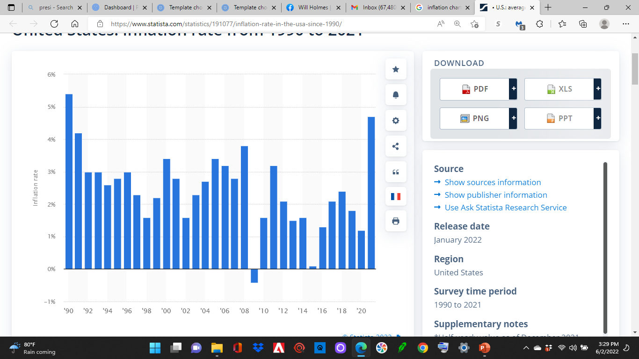
Costs rise each year. Price for this year’s expenses, next year’s growth, and your retirement.
Inflation by Year: 1990 to 2025
If your business is part of your retirement plan, it must be able to support your expenses when you retire. Average inflation is 2% to 3% per year. Over 25 years, costs can double.
’22 ‘24
Inflation
Inflation is a fundamental economic indicator. For example, if an average pair of shoes costs 100 dollars one year and 105 dollars the following year, the inflation rate is five percent. This means the purchasing power of the dollar has decreased. The data presents the average rate of inflation throughout a year. How much will a pair of shoes cost when you retire? Source: https://www.statista.com/statistics/191077/inflation-rate-in-the-usa-since-1990/

Slide 16
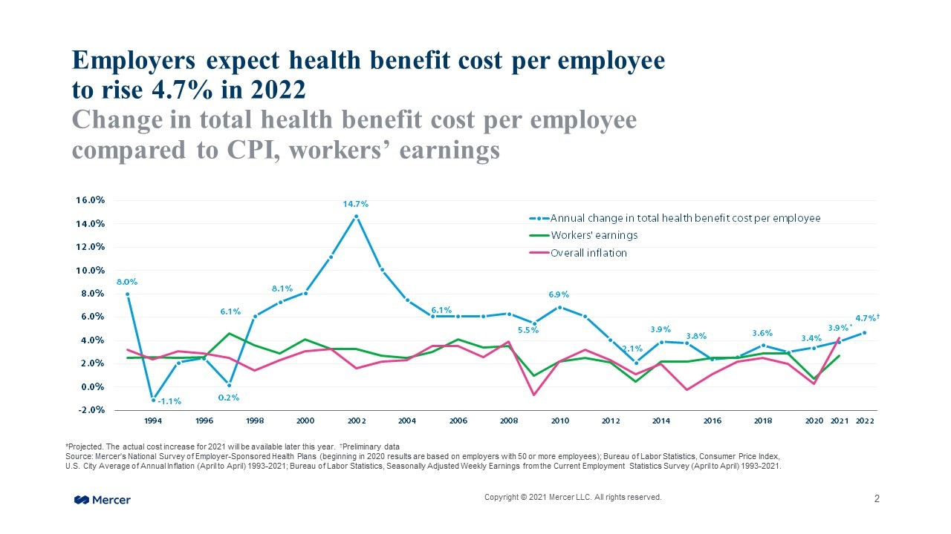



Consider the Rising Costs of Employee Benefits…
Your pricing and projections are based on your team performing at a certain level. If staff can’t meet their numbers, even with management, SOPs, training and retraining, they must be replaced with productive workers who can meet standard.
Copyright 2026 www.whcusa.com

Slide 17

Pricing for Sustainability
Consider these elements when building your price! It’s not just the cost of the cake batter!
Profit
Your Pay
If you don’t include pay for your efforts and your profit in today’s pricing, you can’t replace yourself with a worker, leave day-to-day operations, and focus on your growth. Future profits come from the combined efforts of the workers who replace you in operations.
Copyright 2026 www.whcusa.com

Slide 18

MAKE MONEY FIRST. THEN ADMIN.
Find a Need. Fill a Need. Get Paid. ™
Do you find yourself answering emails, answering phone calls and putting out fires all day? Does it feel out of control and chaotic?
As the Business Owner, you must focus on making money during your money-making hours. First thing you do is work on the opportunity that can make/ lose you the most money the fastest.
Then the second most, then the third most… Once you have made your money then you can decide if you need to do admin. Or maybe, use the money you made to hire an administrative person so you can stay focused on making money. Everyone benefits when you make money!
Work never ends. So, you must control your day and be intentional about hitting your revenue goals. If you don’t, who will? Revenue goals drive behavior and admin work can be delegated. Build something valuable! People will want to work there, and someone may want to buy it.
Copyright 2026 www.whcusa.com

Slide 19
YOU NEED A GREAT TEAM.
Focus on creating profitable systems and teams.
Do you have staff running the day-to-day? What steps are you taking to make this happen so you can focus on growth and sustainability? What will it cost your customer for you to be free to innovate? What is the right mix of 1099s and employees?
Do you want to be involved in the day-to-day? Is it for the love of what you do? Is it fear of delegation? Is it the lack of necessary funding? Is it the lack of ideas and innovation? How can you use technology?
If there is a shortage of people to hire, how can you either automate the tasks or become more attractive to the limited number of qualified people? How serious are you about your growth? What are you willing to sacrifice? What are you willing to change? Will you pay a recruiter or service to assist? Include these expenses in your pricing so your customer can pay for it. Why should someone work for you?
Build profitable systems that run without you, so you can be free to build more profitable systems that run without you. Think bigger than just creating a job for yourself. Create jobs for others and create freedom for yourself!
Copyright 2026 www.whcusa.com

Slide 20


Remember These Key Business Functions!!!
Leadership
Finance/ Accounting
Operations/
Fulfillment
Human Resources
Legal/ Admin/ Security
Marketing
Sales
Technology/ Data
Every business needs these functions, no matter how big or small. Some roles may be filled with technology.
You must segregate duties and put people in roles where they will thrive! Create Job Descriptions and Standard Operating Procedures. Develop a consistent training program! Allow for innovation!
These functions needs to be addressed in your cash flow projections and pricing!
Copyright 2026 www.whcusa.com
20

Slide 21

Your SOPs Allow You to Delegate Tasks
Standard Operating Procedures. Keep it simple!
Example of simple steps:
SOP 1- How to attend a WHC event.
Step 1. Turn on the computer.
Step 2. Type in your username and password.
Step 3. Click on the internet icon.
Step 4. Type https://whcusa.com into the web address bar.
Step 5. Look at the navigation bar and find Events.
Step 6. Click on Events.
Step 7. Choose an event and click purchase a ticket.
Step 8. Type in your name and credit card information.
Step 9. Hit submit. Put the event on your calendar.
Step 10. Attend event on the day and time of event.
Step 1
Step 2
Step 3
Step 4
Step 5
Step 6
Step 7
Step 8
Step 9
Step 10
Note: Set metrics so your team knows what’s expected and you get your ROI!
Copyright 2026 www.whcusa.com
21

Slide 22

Your Schedule Must be Protected!!!
Focus on Boss tasks only!
How much do you want to make per year?
$250K? $150k? $100k?
$120/ hr. $72/ hr. $48/ hr.
Use the customer’s money to hire an admin at $15 PER HOUR, so you can focus on growing the company!
When your pricing is right, you are using the customer’s money to pay your team. Expenses and profit are built in. Every dollar has a job!
Copyright 2026 www.whcusa.com
22

Slide 23
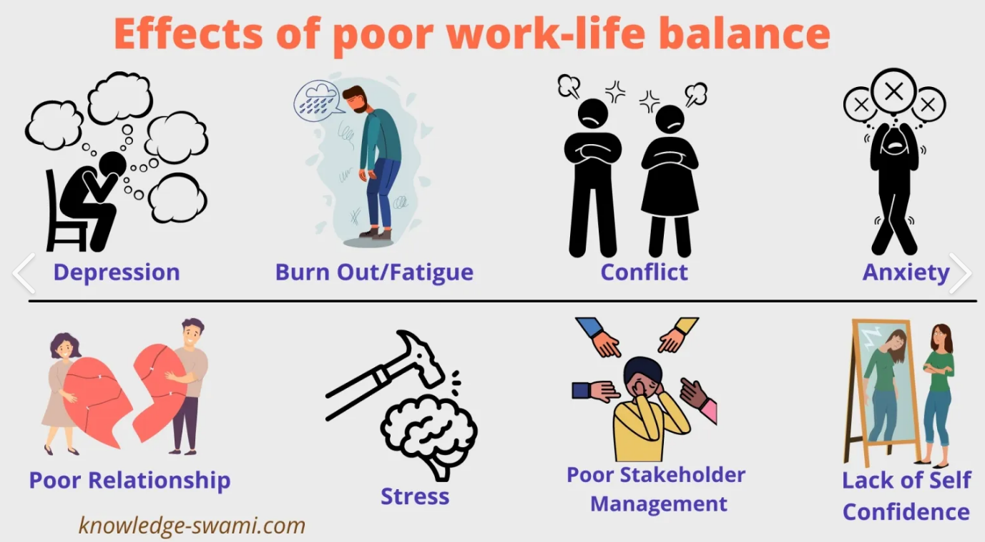



Our priorities require our time and attention. Build infrastructure that creates freedom.
What is important to you?
Copyright 2026 www.whcusa.com
23

Slide 24
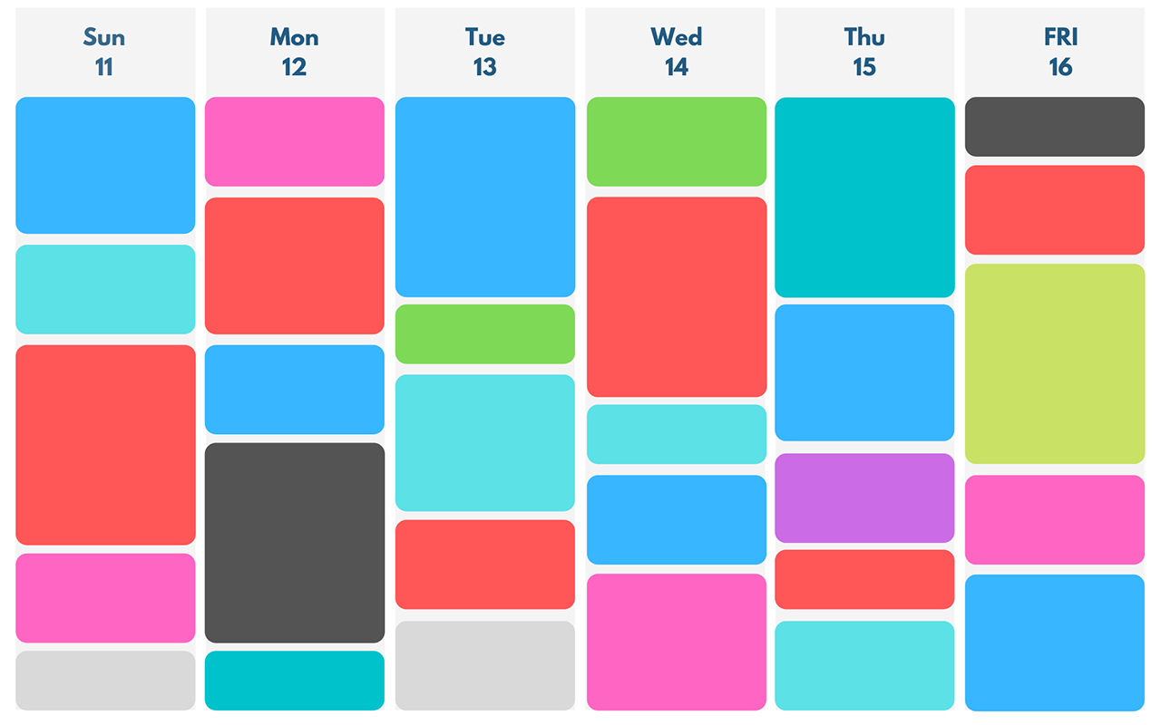
Time Blocking Works
Set Your Priorities
Manage your schedule. Don’t let it manage you!
First, create a master calendar and block time for family, working out, sleep, meditation, innovation (whatever is important to you, personally). Connect to an auto scheduler app.
Then, designate meeting links for business development, and important meetings that will further the growth of the company. Your auto scheduler can manage the rest.
Acuity Scheduling
Calendly
Look for industry specific scheduling tools
Copyright 2026 www.whcusa.com
24

Slide 25
What Do You Want to Be?
A Businessperson who creates profitable systems? Or the system that creates profits?
Customer Need
Product/ Service
Team/ Tech/ Processes
Marketing/ Sales
Fill Order and Get Paid
Customer Need
Product/ Service
Team/ Tech/ Processes
Marketing/ Sales
Fill Order and Get Paid
Customer Need
Product/ Service
Team/ Tech/ Processes
Marketing/ Sales
Fill Order and Get Paid
Now that you know what you want, let’s use projections to plan the growth of your business. Projections will tell us how much capital we’ll need to make it happen!
Copyright 2026 www.whcusa.com
25

Slide 26

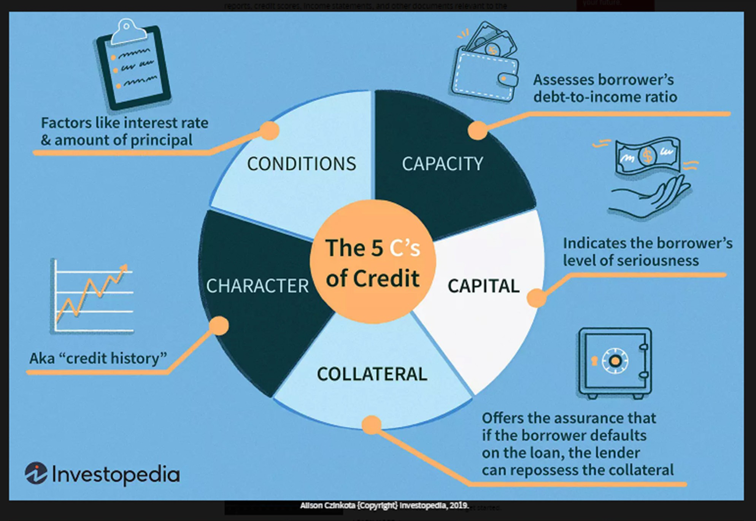

PREPARING FOR CAPITAL
Essential Documentation
- The 5 Cs
Regardless of the type of financing needed, most banks or lending institutions will be interested in both your business and personal financials.
Great article on Investopedia:
https://www.investopedia.com/terms/f/five-c-credit.asp
Copyright 2026 www.whcusa.com

Slide 27


PREPARING FOR CAPITAL
Essential Documentation
Business registration documents (whichever applies to your business)
Articles of Incorporation/ Organization or Bylaws and/ or Operating agreement or Partnership Agreement
Complete Loan Application and Personal ID
2- 3 years of Personal Taxes
2- 3 years of Business Taxes
6 Months of Personal Bank statements
(most recent checking, savings, etc.)
6 Months of Business Bank Statements
(most recent checking, savings, etc.)
Business Plan (cash flow projections, market research, competitive analysis, as well as any documentation you may have now that shows the monthly business income, expenses and pricing model)
Collateral information (Car that is paid off, make model, equipment, business assets, cash, co-signer, etc.)
If you will be using a vehicle as collateral, a clean copy of the car title as well as proof of insurance.
Summary of the use of funds
Management Resume and P&L
and Balance Sheets prepared by a CPA
Financial Discipline?
Match projections?
Copyright 2026 www.whcusa.com
20

Slide 28
INTRODUCE THE COMPANY PRODUCT/ SERVICE TEAM UNFAIR ADVANTAGE & GROWTH STRATEGY HOW MUCH DO YOU NEED?/ WHAT IS THE ASK?
Business Plan: Executive Summary
Complete your cash flow projections first!
Write the Executive Summary and Conclusion last.
Briefly tell your reader what your company is and why it will be successful. Include your mission statement, your product or service, and basic information about your company’s leadership team, employees, and location. You should also include financial information and high-level growth plans if you plan to ask for financing. This is where you ask for what you want from the reader!!! Write this last.
Remember your audience! Lender- Can you pay us back?
Investor- Can we make 5x or 10x our investment?
Partner- Can I get a good ROI? Different versions based on different projections!
Copyright 2026 www.whcusa.com
www.whcusa.com/contact

Slide 29
*Foundation for your conversation with lenders *Shows your aspirations, timing, and planned milestones *Shows your ability to repay loans and generate ROI *Details “THE ASK” and the expenses involved *Shows profitability and growth potential *Shows the timing of money in and money out for your business *It is the budget for your growth plan
WHY ARE CASH FLOW PROJECTIONS IMPORTANT?
Copyright 2026 www.whcusa.com
www.whcusa.com/contact

Slide 30
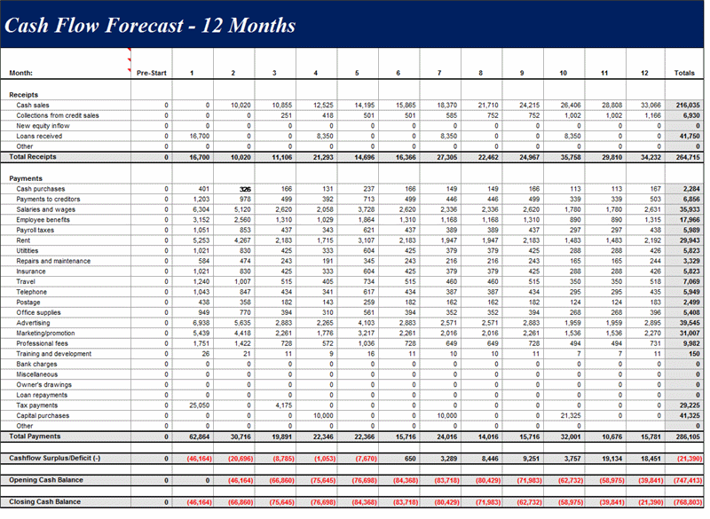
12 Month
Cash Flow Forecast Revenue
Revenue Drives Behavior! Revenue comes from sales and covers your expenses and reinvestments. Your profit is what you choose to keep.
Use conservative revenue projections! Consider payment cycles/ terms and seasonality.
Future purchases? Hiring? You’ll need to sell more to cover it.
How can you use your existing infrastructure to create multiple streams of revenue?
How can you sell more services and products to your existing customer?
What needs does new customer want you to fill? Talk to them!
Download at www.whcusa.com/cashflow

Slide 31
What is $1 million in revenue?
You need to create ways to generate $83,334 per month in sales.
That is $4,167 per day if you’re open 20 days per month.
That’s $521 per hour if you're open 8 hours per day.
That’s $348 per hour if you're open 12 hours per day.
That is $2,778 per day if you’re open 30 days per month.
That’s $348 per hour if you're open 8 hours per day.
That’s $232 per hour if you're open 12 hours per day.
You must create quarterly/ monthly/ daily sales goals for your team!
www.whcusa.com
Copyright 2026 www.whcusa.com

Slide 32
What is $1 million in revenue?
You need to create ways to generate $83,334 per month in sales.
Average price of Services?
Charge $100 per hour? That’s 834 total hours per month. If you have FT staff, you're billing your clients for 5 to 6 FTEs at $100 per hour. You pay them a lesser amount so you can make a profit.
Charge $5000 per project? That’s about 17 projects per month or 200 projects per year.
Charge $50,000 per project? That’s about 2 projects per month or 20 projects per year.
Think about the infrastructure and target clients you’ll need to make this happen. Don’t market to people who can’t afford to pay you at this level. They aren’t your clients anymore. We are in business to generate revenue and make a profit.
www.whcusa.com
Copyright 2026 www.whcusa.com

Slide 33
Average price?
Average price of your services and products?
You may offer your customers a wide range of choices. For the purposes of projecting volume of sales, consider the range of your prices but identify the average price that you charge your customers. This helps plan for the infrastructure needed to sell higher volumes.
Example: Salon Services
$35 for a hair wash. $150 for a hairstyle. ($35 + $150)/ 2= $92.5 on average for a service.
To hit 1 million in revenue, that salon owner would need to consider how much infrastructure would be needed to support 10,811 services.
$1,000,000/ $92.5= 10,811 services
This is NOT a perfect number. It is a start to assess needed infrastructure.
www.whcusa.com
Copyright 2026 www.whcusa.com

Slide 34
12 Month
Cash Flow Forecast Expenses
How much will it cost to make it happen? This is the ask when speaking to lenders and the foundation for sales goals.
Loan repayment, estimated tax payments, insurance, reinvestment.
Are you paying yourself? You must cover your pay in your pricing if you plan to sell your business or get out of the day to day. Your personal expenses determine your monthly pay.
Remember materials, time, labor, marketing costs, taxes, fees, normal business purchases, inventory, packaging, transportation, distribution, office, utilities…
Download at https://whcusa.com/cashflow/

Slide 35
Annual Profit Goal?
How much do you want to bring home each year or month after all your expenses?
You should run your business. It should not run you. Your business should be a tool to generate the money you need to live the life you want.
Your business should be profitable. Otherwise, it is an expensive hobby and a liability. If it is not making a profit, you need to move quickly to find a fix. An unprofitable business it will drain you mentally and financially and probably negatively affect your health and home life.
Also, you should be paying yourself. And we recommend that you consider your pay an expense. Why? Someone has to do the work if you sell the business or get sick. That labor should be accounted for in your pricing. Plus, lenders want to see that you pay yourself.
What is left over after expenses is profit. So, how much?
www.whcusa.com
Copyright 2026 www.whcusa.com

Slide 36
Cost to Make One?
How much does it cost to make one of whatever you sell?
Look at your expenses for the month. Divide that number by your average number of sales per month.
Total Monthly Expenses/ Average Number of Monthly Sales= Average Cost to Provide One Product or Service to Customer
This is NOT a perfect number. But what it does is that it requires you to look at ALL your expenses for the month and determine HOW MANY sales you make in a month.
You should include everything in your expenses! It’s not just the ingredients to make a cupcake. It’s also your business insurance, utilities, marketing, your pay, your team’s pay and any other business expenses involved in making that cupcake. This will help you get closer to the right price to charge your customers.
www.whcusa.com
Copyright 2026 www.whcusa.com

Slide 37
Break Even Point?
Knowing your average price and your total monthly expenses helps you set minimum sales goals and assess pricing.
Look at your expenses for the month. Determine how much revenue you need to bring in to keep the lights on and cover your expenses.
Divide that number by your average price.
Total Monthly Expenses/ Average Price= Minimum Sales Goal to Stay Open
That Minimum Sales Goal to stay open is a VERY important number. This doesn’t include any profit. But once you know this number, you can start to determine if you can keep sales volume the same and increase pricing or keep pricing the same and increase sales volume. Or maybe increase both.
www.whcusa.com
Copyright 2026 www.whcusa.com

Slide 38

The Trade of Money for Time
Employees trade their time for money.
As the business owner, you hire people and trade your money for their time.
This frees you to:
Think, innovate and work in your “talent area.”
Find new ways to grow the business.
Find new ways to make more money so you can hire more people so you can make more money.
Copyright 2026 www.whcusa.com

Slide 39

If workers do all the work, why should the Boss get rich???
Business Owners create opportunities for all the stakeholders to benefits from their idea.
Workers get paid.
Suppliers get paid.
The government gets paid in taxes.
Workers, suppliers and the government spend that money to buy other products and services.
All from the business owner taking the risk and making their idea a reality.
Embrace the abundance that comes from manifesting your idea!
Copyright 2026 www.whcusa.com

Slide 40
How Do You Want to Make Your Money?
$70k in profit
$100k in additional expenses
$70k in profit
$100k payroll
Scenario 1. You work alone, all day and all night. You generate $100k in sales revenue. After expenses, you keep $70k for yourself (70% profit). There is no one else to pay because you do everything.
Scenario 2. You aren’t involved in the day-to-day of your business. Your team of 2 handles all the work but you check-in to make sure they have what they need. Their payroll is $100k. Outsourced roles, plus other expenses are $100k. The company generates $270k in sales revenue. After expenses, you keep $70k for yourself (26% profit).
Copyright 2026 www.whcusa.com
40

Slide 41
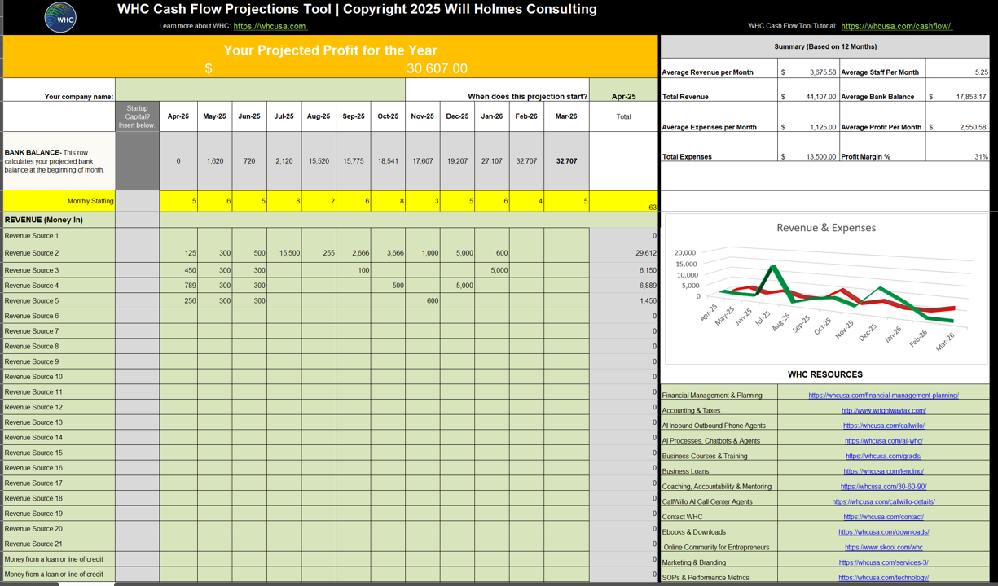

WHC 12 Month
Cash Flow Forecast Tool
Tell your story with numbers! Use actual cash flow based on reality. No place holders or even splits.
Slow seasons? What else can I sell?
Every action costs money and requires something to happen prior.
Set milestones and sales goals or funding needs for hiring, major purchases, expansion.
More sales usually require more or different marketing and that usually costs money.
Savings Plan? Investing Plan? Your customer pays for your retirement in every purchase.
Include repayment plan for loans/ lines of credit/ other debt.
Copyright 2026 www.whcusa.com
Download at https://whcusa.com/cashflow/

Slide 42
WHC 12 Month
Cash Flow Forecast Tool
ROLE PLAY!
I need a brave volunteer.
Agenda
Using the WHC Cash Flow Tool
Expenses and Milestones
Revenue to Support Growth
Profitability
Creating an Action Plan
Cash Flow is a Lender’s Love Language
Copyright 2026 www.whcusa.com
Download at https://whcusa.com/cashflow/

Slide 43

Graduation and Final Presentation
Copyright 2026 www.whcusa.com

Slide 44

GRADUATION
AGENDA
Facilitators: Barbara Quaye, Dr. Imani Coles and Will Holmes
Opening Remarks from Anne Arundel County
Final Presentations
Feedback from Judges
Feedback from Businesses
Graduation

Slide 45

Final Presentation Instructions
Congratulations on taking steps to grow your business!
This template is designed to make preparation of your 15-minute final presentation as easy as possible.
Notice the words in green. Those are instructions. They should be deleted before you give your final presentation.
Note that there are 15 presentation slides. You should practice presenting each slide within 45 seconds. We recommend keeping your script to 60 words or less per slide. This will allow you to cover all the details in the 15-minute timeframe.
You can change the design of the slides but please do not change the order of the requested information when you give your presentation.
Aesthetics and grammar matter. Please take the time to review your font size and colors for consistency. Also, please take the time to do a spell check and grammar check before you present to the judges.
Week 6’s homework will give you a script for this presentation. Schedule time to review this presentation with your mentors before Week 7’s practice presentation. Use Week 8 to refine your script and practice your timing before class. Week 8’s class is graduation.
This presentation can be used to pitch your business to potential investors, partners and lenders after you complete this program. Please take advantage of all the program’s resources and put time into making this presentation a true representation of you and your business!
Remember to delete this slide and all the green instructions before you present. See you soon! -Will Holmes and the WHC Team

Slide 46
Introduction
Your Logo
Business Owner:
Name of Business:
Founded: (year)
Good evening. My name is ________________. I am the Owner of ____________ (business name). We are a ____________ (type of business) that provides ___________ (type of services/ products) to ______________ (type of customer/ client/ organization) in the ______________ (geographical region). Our _________ (products/ services) help our clients/ patients/ customers _____________ (what need your business fills).

Slide 47
Our Why
Your Logo
Mission or Core Values or Company Culture or Why you started this business:
(Choose one! In one minute, share something that lets the audience know why you do what you do. Let us know what is important to you as the leader of your organization. This should create emotion in the hearts of the viewers.)

Slide 48
Past Challenges
Your Logo
Past Challenges | Impact | How You Overcame the Challenge
(In one minute, describe 3 past challenges to the growth of your business… example: access to capital, hiring, scaling, technology, certifications. Also, describe the impact these challenges had on your growth and how you overcame the challenge.)

Slide 49
Meet the Team
Your Logo
(In one minute, introduce your team. Give names and add pics if possible. If it’s just you, that’s fine, too!)

Slide 50
Products & Services
Your Logo
(In one minute, describe your products and services. Show pics if possible.)

Slide 51
Our Target Buyers
Your Logo
Customer Type | Demographics & Location? | What is the potential size of the market in the target area? | What are their Needs? | How often do they buy? | How do they find info to make buying decisions?
(In one minute, describe your customer types and their key details. Use numbers to help us better understand the size of the market and the opportunity for your business!)

Slide 52
Testimonials
Your Logo
Customers usually say we are…
1
2
3
(In one minute, describe what your customers/ clients/ patients say about your business. If possible, display 2 to 3 testimonials, or a screen shot of your gold stars. Do not read the reviews to the audience. Highlight consistent themes in what they say about your business.)

Slide 53
Current Pricing
Your Logo
Current Monthly Sales Volume (# of transactions or average $) | Current Monthly Expenses ($) | Current Price Range ($) | Do we plan to raise our prices in the next 12 months? (Yes or No)
Current Monthly Sales Volume: ___ (Average number of sales or revenue in recent months)
Current Monthly Expenses: $ ______ (Average amount of business expenses in recent months)
Current Pricing Range: $____ to $____ (State the lowest and highest prices for the categories of what you offer)
Do we plan to raise our prices in the next 12 months? (Yes or No)

Slide 54
Competition
Your Logo
Competitor | Their Location | Their Strengths | Comparison
(Google your category of business in your geographical area. In one minute, describe their strengths and how you are stronger.)

Slide 55
Past Sales Data
Your Logo
Year | Revenue ($) | Expenses ($) | Profit ($)
2023
2024
2025
(Remember, Profit = Revenue – Expenses. In one minute, state the revenue, expenses and profit for the past three years. If you had a negative or took a loss, that’s okay! If you were not open during that year, just delete that line.)

Slide 56
Projections
Your Logo
Metric | 12-Month Projections (Future)
Projected Revenue ($)
Projected Expenses ($)
Projected Profit ($)
Projected Number of New Hires (#)
Do we need additional funding? (yes or no)
(In one minute, state the projected revenue, expenses and profit for the next 12 months or calendar year. Also, state the number of projected new hires. Additionally, state if you need additional funding to hit your goals.)

Slide 57
New Technology
Your Logo
Technology Enhancements | Projected Impact | Target Implementation Date
(In one minute, state your top 3 technology enhancements planned for the next 12 months. Describe the impact you expect these changes to have on your business and when you plan to implement these changes.)

Slide 58
3 things I learned…
Your Logo
What I learned/ gained | Significance to the growth of my business
(In one minute, describe three things you learned or gained during the program and how that info will help you plan the growth of your business.)

Slide 59
Next Steps
Your Logo
Action | Date | Expenses | Return on Investment
(In one minute, describe the next 3 steps you plan to take in the next 6 to 12 months to grow your company. Give dates and the estimated expenses involved. Then describe the Return on Investment. For example: We plan to hire more people/ open a new location/ add new technology to reduce expenses, increase revenue, increase efficiency, increase sales, to create more jobs in the community… Use numbers when describing the ROI.)

Slide 60
Your Logo
Thank You/ Q&A
Business Owner
Business Name
Website
Email
(Judges, I am _______ (your name) and my business is _______ (name of business). I invite you to contact me when you, or someone you know, needs ____________(what you offer). Let’s connect to discuss how we can work together. Thank you for your time and I am ready to answer your questions.

Slide 61
Thank You! Q&A
Copyright 2026 www.whcusa.com
61

